Slide 1
Immunotherapies and Immune-related Toxicities
FLASCO Fellows Day, March 19, 2022
Orlando, FL
Matthew A. Smith, PhD, MSPH

Slide 3

Targeting the Immune System in Cancer

Slide 4


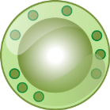
Normal Adaptive Immunity and Tolerance
Targeting the Immune System in Cancer
Adaptive Immunity
CD4⁺
helper T cell
Helper T cells then produce cytokines that stimulate the expansion and differentiation of the CD8⁺ T cells¹
Dendritic cells (APCs) ingest tumor-specific antigens and present them to CD8⁺ T cells and to CD4⁺ helper T cells using MHC molecules¹
Ingested tumor-specific antigen
Costimulator
Cytokines
(+) Signal 2
CD8⁺ cells undergo clonal expansion and differentiation¹
+
TCR
CD8⁺
T cell
Dendritic cell
Effector CTLs
Tolerance
B7.1,2/CTLA4
(–) Signal 2
-
Tolerance (anergy)²
TCR
Reduce T-cell reactivity to self-antigens²
APC, antigen-presenting cell; CTL, cytotoxic T lymphocyte; CTLA4, cytotoxic T lymphocyte–associated protein 4; MHC, major histocompatibility complex; TCR, T-cell receptor. 1. Abbas AK, et al. Basic Immunology: Functions and Disorders of the Immune System. 4th ed. Philadelphia, PA: Saunders; 2012. 2. McCoy KD, Le Bros G. Immunol Cell Biol. 1999;77:1-10.

Slide 5



Immunotherapy Targets the Antitumor Immune Response Through Active and Passive Strategies¹⁻⁴
Targeting the Immune System in Cancer
Peptide vaccine^{2,4}
DC vaccine^{2,4}
Genetic vaccine^{2,4}
CTLA4³
PD-1³
2
3
Active immunotherapy attempts to stimulate the host's intrinsic immune response⁴
CD40⁴
CD137³
1
Cytokines
(e.g., IL-2, IFN, and IL-21; may act through APCs)^{2,3}
4
Tumor cell
OX40³
8
Passive immunotherapy is the transfer of active immunity in the form of ready-made factors into individuals⁴
5
6
7
T-cell cloning⁴
TCR or CAR
genetic engineering⁴
= CTL
NK-cell recruitment
by antibodies^{3,4}
= Stimulator
T-cell recruitment
via T-cell bispecifics¹
= Inhibitor
CAR, chimeric antigen receptor; CTLA4, cytotoxic T lymphocyte–associated protein 4; DC, dendritic cell; NK, natural killer; TCR, T-cell receptor. 1. Baeuerle PA, Reinhardt C. Cancer Res. 2009;69:4941-4944. 2. Chen DS, Mellman I. Immunity. 2013;39:1-10. 3. Merelli B, et al. Crit Rev Oncol Hematol. 2014;89:140-165. 4. Mellman I, et al. Nature. 2011;480:480-489.

Slide 6
Cancer Immunity Cycle

Slide 7
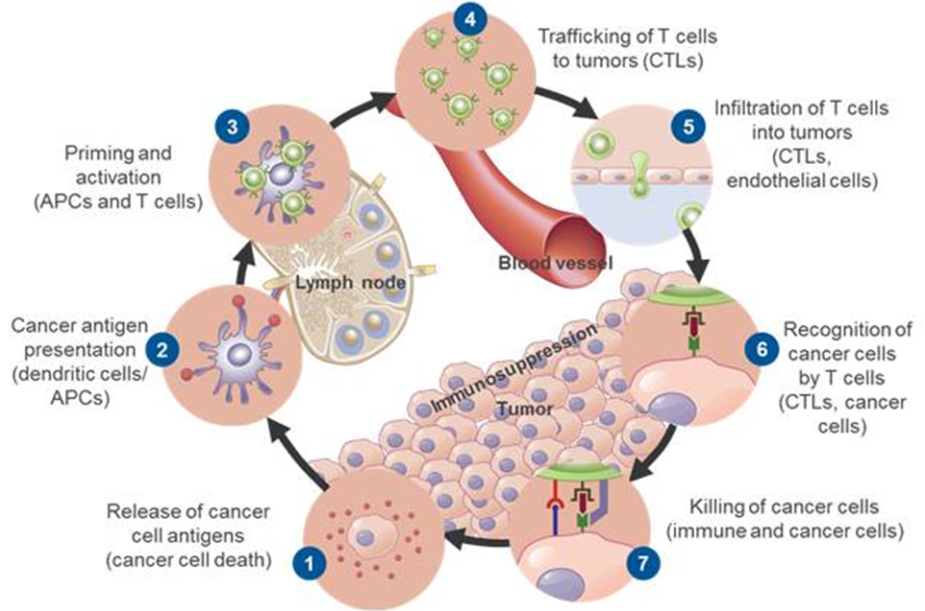
Overview
Cancer Immunity Cycle
A series of stepwise events occur and expand iteratively for a successful antitumor immune response
Each step of this cycle helps to balance stimulatory factors that promote the immune response against cancer and inhibitory factors that prevent autoimmunity
APC, antigen-presenting cell; CTL, cytotoxic T lymphocyte. Chen DS, Mellman I. Immunity. 2013;39:1-10.

Slide 8
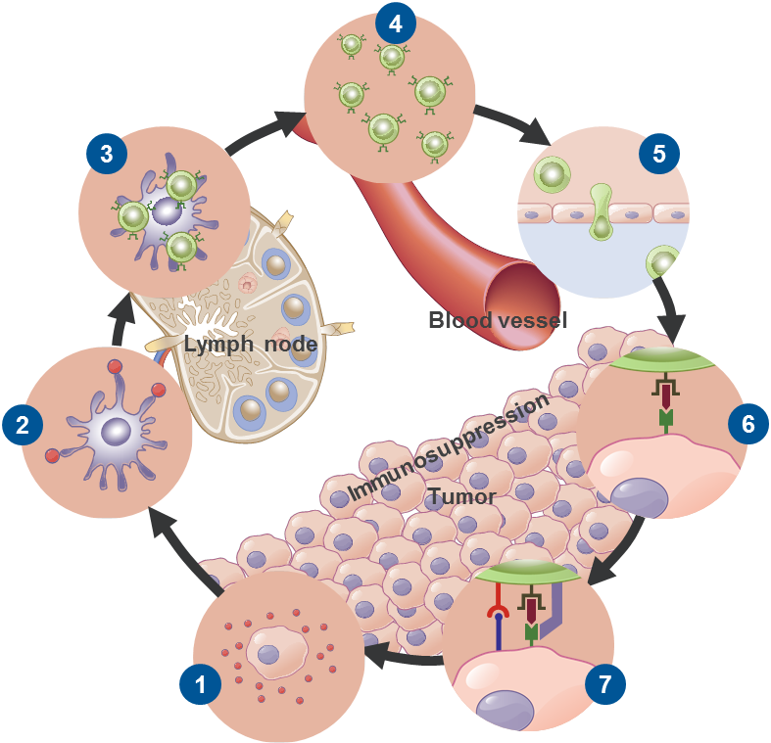
Stimulatory and Inhibitory Factors
Cancer Immunity Cycle
Priming and activation
Trafficking of
T cells to tumors
CX3CL1
CXCL9
CXCL10
CCL5
Each step requires a coordination of stimulatory and inhibitory factors
Stimulators promote immunity. For example
In lymph nodes, CD28 interaction with B7.1 promotes T-cell development / proliferation
Inhibitors keep the process in check to reduce immune activity and prevent autoimmunity. For example
In lymph nodes, CTLA4 interaction with B7.1 inhibits T-cell development / proliferation
In the tumor bed, PD-L1 interaction with PD-1 or B7.1 modulates an active immune response
CD28/B7.1
CD137/CD137L
OX40/OX40L
CD27/CD70
HVEM
GITR
IL-2
IL-12
CTLA4/B7.1
PD-L1/PD-1
PD-L1/B7.1
Prostaglandins
Infiltration of T cells
into tumors
LFA1/1CAM1
Selectins
VEGF
Endothelin B receptor
Cancer antigen presentation
Recognition of cancer cells by T cells
TNF-α
IL-1
IFN-α
CD40L/CD40
CDN
ATP
HMGB1
TLR
IL-10
IL-4
IL-13
T-cell receptor
Reduced pMHC on cancer cells
Killing of cancer cells
IFN-γ
T-cell granule content
PD-L1/PD-1 LAG-3
PD-L1/B7.1 Arginase
IDO MICA/MICB
TGF-β B7-H4
BTLA VISTA
TIM-3/phospholipids
Release of
cancer cell antigens
Immunogenic cell death
Tolerogenic cell death
CTLA4, cytotoxic T lymphocyte–associated protein 4; IDO, indoleamine 2,3-dioxygenase; pMHC, peptide-major histocompatibility complex; TLR, toll-like receptor. Chen DS, Mellman I. Immunity. 2013;39:1-10. Mellman I, et al. Nature. 2011;480:480-489.

Slide 9
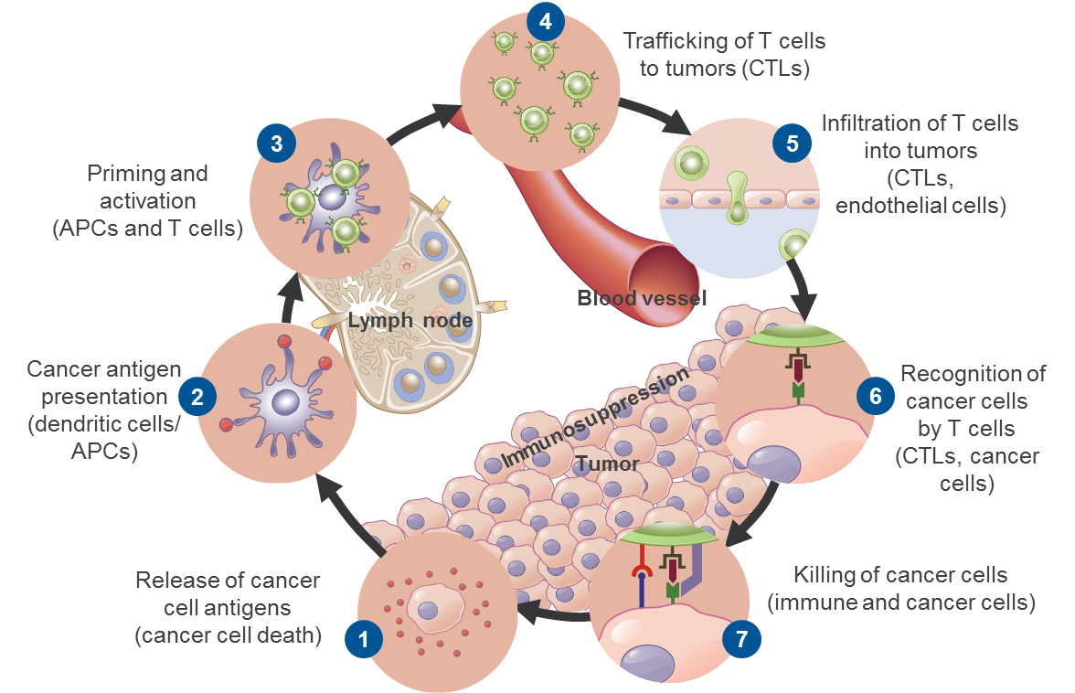
Mechanisms of Escape From Immune Control in Cancer –
Direct Mechanisms
Cancer Immunity Cycle
Direct Mechanisms of Escape
The Cancer Immunity Cycle¹
Step 1
Step 1
Downregulation of antigen presentation by antigen loss; decreased expansion of MHC class I and antigen-processing machineries²
Step 6
Lowered expression of MHC class I molecules^{1,2}
Step 7
PD-L1 expressed on tumor cells binds to PD-1 receptors on tumor-specific T cellsa, inhibiting activation of the T cell and protecting the tumor cell from destruction¹⁻³
Expression/overexpression of key molecules⁴
Anti-apoptotic molecules
Cytotoxic-protective molecules
Inhibitory receptors
Mutations in death receptor signaling pathways (e.g., FAS, TRAIL)⁴
Step 6
Step 7
APC, antigen-presenting cell; CTL, cytotoxic T lymphocyte; MHC, major histocompatibility complex. a CD4+ and CD8+ cells. 1. Chen DS, Mellman I. Immunity. 2013;39:1-10. 2. Mellman I, et al. Nature. 2011;480:480-489. 3. Tsushima F, et al. Blood. 2007;110:180-185. 4. Portt L, et al. Biochim Biophys Acta. 2011;1813:238-259.

Slide 10
Mechanisms of Escape From Immune Control in Cancer –
Indirect Mechanisms
Cancer Immunity Cycle
Indirect Mechanisms of Escape
The Cancer Immunity Cycle¹
Step 3
Step 3
T-cell activation suppressed by tumor-released IDO and IL-10²
Tumors produce VEGF, IL-6, GM-CSF, IL-10^{2,3}
Dendritic cell development inhibited by
tumor-produced molecules (i.e., gangliosides)^{2,4}
Step 5
Proliferation of immunosuppressive myeloid cells by tumor-released cytokines (VEGF, IL-1B, GM-CSF)^{2,3,5}
Vascular changes in the tumor environment
(i.e., VEGF reduces T-cell infiltration)²
Step 6
Conversion of naïve CD4+ T cells into T_{reg} cells by tumor-released TGF-b suppresses T cells and APCs in the tumor bed²
Step 7
T-cell activation in the absence of appropriate costimulation leads to anergy^{1,5}
Lowered expression of MHC class I molecules²
Step 5
Step 6
Step 7
APC, antigen-presenting cell; CTL, cytotoxic T lymphocyte; GM-CSF, granulocyte macrophage colony stimulating factor; IDO, indoleamine 2,3-dioxygenase; MHC, major histocompatibility complex; T_{reg}, regulatory T cell. 1. Chen DS, Mellman I. Immunity. 2013;39:1-10. 2. Mellman I, et al. Nature. 2011;480:480-489. 3. Wang Y, et al. Cancer Res. 2014;74:716-726. 4. Jales A, et al. Immunology. 2011;132:134-143. 5. Merelli B, et al. Crit Rev Oncol Hematol. 2014;89:140-165.

Slide 11
Several Targets in the Cancer Immune Cycle Are Currently
Under Evaluation
Cancer Immunity Cycle
Trafficking of T cells
to tumors (CTLs)
Step 1
Priming and activation
Anti-PD-1
Anti–PD-L1
Anti-CTLA4
Anti-CD137 (agonist)
Anti-OX40 (agonist)
Anti-CD27 (agonist)
IL-2
IL-12
Step 1
Although not developed as immunotherapies, chemotherapy, radiation therapy, and targeted therapies can primarily promote the release of cancer cell antigens into the circulation
Vaccines can primarily promote cancer antigen presentation
Anti-CTLA4 and anti–PD-L1 antibodies can primarily promote priming and activation of T cells
VEGF inhibitors can potentially promote T cell infiltration into tumors
Step 7
Anti–PD-L1 or anti-PD-1 antibodies can primarily promote killing of cancer cells
Infiltration of T cells
into tumors
Anti-VEGF
Step 2
Cancer antigen presentation
Vaccines
IFN-α
GM-CSF
Anti-CD40 (agonist)
TLR agonist
Step 3
Recognition of cancer cells by T cells
CARs
Step 5
Release of
cancer cell antigens
Chemotherapy
Radiation therapy
Targeted therapy
Killing of
cancer cells
Anti–PD-L1
Anti–PD-1
IDO inhibitors
Step 7
CAR, chimeric antigen receptor; CTL, cytotoxic T lymphocyte; CTLA4, cytotoxic T lymphocyte–associated protein 4; GM-CSF, granulocyte-macrophage colony-stimulating factor; IDO, indoleamine 2,3-dioxygenase; TLR, toll-like receptor. Chen DS, Mellman I. Immunity. 2013;39:1-10.

Slide 12
Targeting the PD-L1/PD-1 Axis

Slide 13
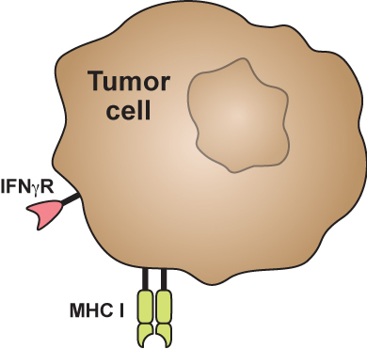
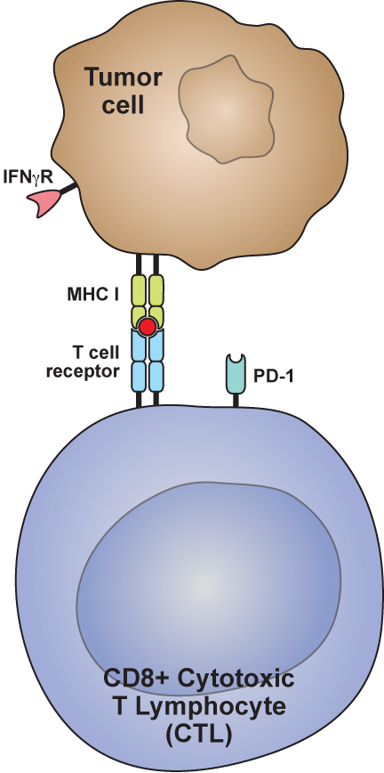
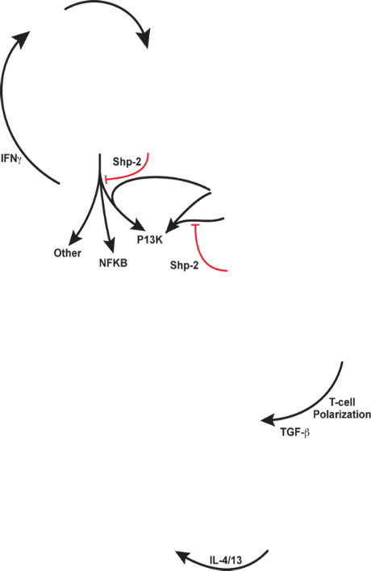
Adaptive PD-L1 Expression by Tumors
Targeting the PD-L1/PD-1 Axis
Cancer cells develop many mutations that create proteins that can make them appear foreign to the immune system^{1,2}
These foreign protein fragments can be presented to T cells by tumor cells via MHC I¹
MHC I, major histocompatibility complex class I. 1. Chen DS, et al. Clin Cancer Res. 2012;18:6580-6587. 2. Herbst RS, et al. ASCO 2013. (abs 3000).

Slide 14
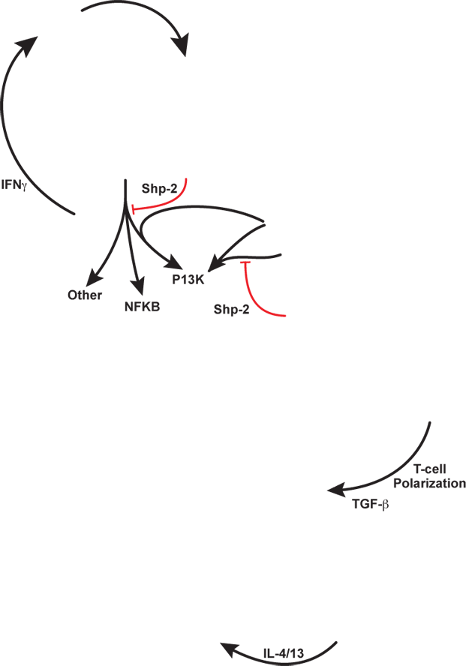

Adaptive PD-L1 Expression by Tumors (cont.)
Targeting the PD-L1/PD-1 Axis
During the immune attack, T cells secrete immune-enhancing cytokines (i.e., IFN-γ)¹
Cancer cells can evade immune attack by expressing PD-L1 as a response to enhancing cytokines^{1,2}
IFN-γ–mediated
upregulation of tumor PD-L1
B7.1
MHC I, major histocompatibility complex class I. 1. Chen DS, et al. Clin Cancer Res. 2012;18:6580-6587. 2. Herbst RS, et al. ASCO 2013. (abs 3000).

Slide 15
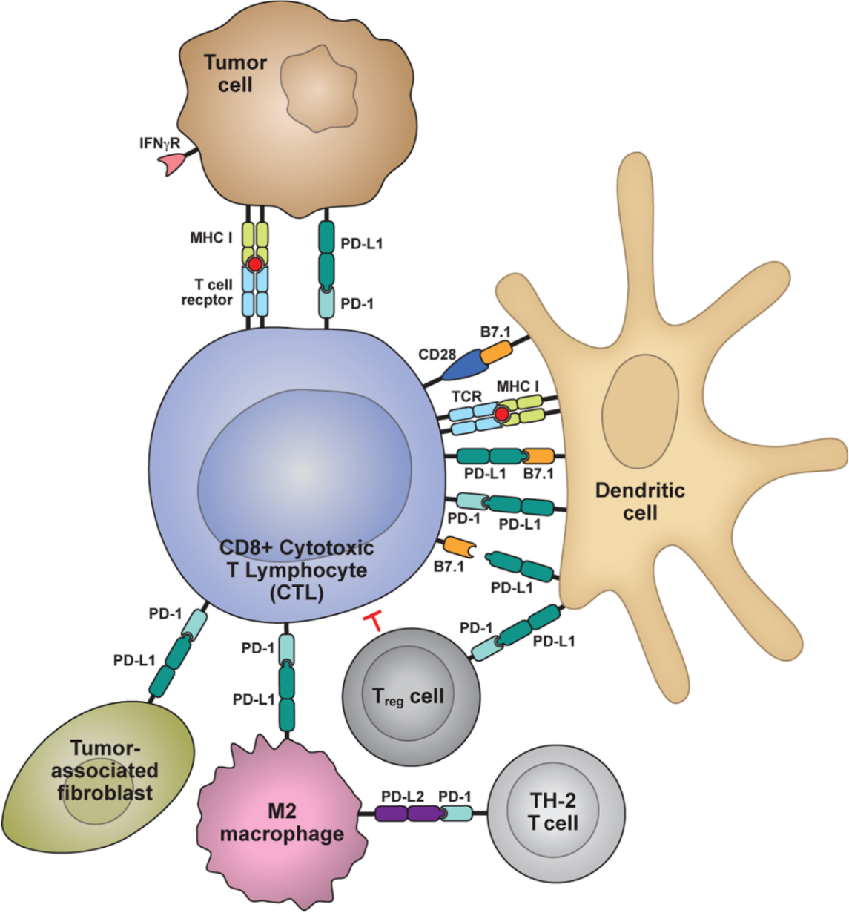
Adaptive PD-L1 Expression by Tumors (cont.)
Targeting the PD-L1/PD-1 Axis
In the tumor microenvironment, both tumor cells and key immune cells (macrophages, dendritic cells) express PD-L1
As tumor cells sense an immune attack, PD-L1 is turned on (expressed)
PD-L1 normally binds to PD-1 and B7.1 (costimulator) to dampen or shut down immune response to prevent excessive inflammation by regulating T-cell responses to antigens
IFN-γ–mediated
upregulation of tumor PD-L1
PD-L1/PD-1–mediated inhibition of tumor cell killing
receptor
B7.1
Priming and activation of T cells
Stromal PD-L1 modulation
of T cells
Immune cell modulation of T cells
T_{h}2
PD-L2–mediated inhibition of T_{h}2 cells
MHC I, major histocompatibility complex class I; Th2, helper T cell. Chen DS, et al. Clin Cancer Res. 2012;18:6580-6587.

Slide 16
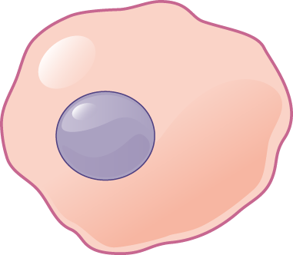


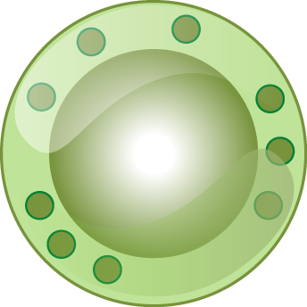


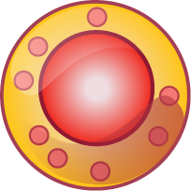

PD-L1/PD-1 Are Involved in a Range of Complex Immune Interactions
Targeting the PD-L1/PD-1 Axis
PD-L1 is expressed on a range of cell types in the immune system and activation of
PD-L1/PD-1 signaling can regulate many functions
Tumor-associated APCs can regulate antitumor
T-cell responses through the
PD-L1 pathway
IFN-γ–mediated
upregulation of tumor PD-L1
PD-L1/PD-1–mediated inhibition of tumor cell killing
Tumor
cell
IFN-γR
Dendritic
cell
Tumor-associated
fibroblast
CD8⁺ cytotoxic
T lymphocyte
(CTL)
Stromal PD-L1 modulation of T cells
PD-L1/B7.1 immunosuppression of T cells
PD-L1/PD-1 priming and activation of T cells
Immune modulation of
T_{reg} cells
PD-L2
PD-1
T_{reg}
cell
CD28
B7.1
Macrophage
T_{h}2
T cell
PD-L1
B7.1
MHC I
TCR
PD-L2/PD-1–mediated inhibition of T_{h}2 T cells
PD-L1
PD-1
APC, antigen-presenting cell; MHC I, major histocompatibility complex class I; TCR, T-cell receptor; Th2, helper T cell; Treg, regulatory T cell. Chen DS, et al. Clin Cancer Res. 2012;18:6580-6587.

Slide 17
Immune-Related Adverse Events With Checkpoint
Inhibitors

Slide 18
Objectives
Immune-Related Adverse Events With Checkpoint Inhibitors
Review the spectrum of immune mediated adverse events (irAEs) induced by immune checkpoint inhibitors (ICIs)
Review the kinetics of irAEs with ICIs
Discuss the effect of baseline corticosteroid use on outcome with ICIs
Review national guidelines for the management of irAEs

Slide 19
The Cancer–Immune Set Point:
Multivariate Factors Influence Tolerance and Immunity
Immune-Related Adverse Events With Checkpoint Inhibitors
N
Tolerance
Immunity
Cancer immunity is influenced by a complex set of tumor, host and environmental factors¹
Suppressed
Inflammation
T_{Regs}
TGFβ
IFN I, II
TLR
ligands
IL-4
IL-12
Cytosol
sensor
ligand
NOD 2,1
IL-10
MDSCs
IL-17
CD4
T cells
IL-13
NRP-1
IL-23
CD8
T cells
The cancer-immune set point is considered the threshold that must be surpassed for a person with cancer to respond to immunotherapy and varies between individuals
PD-L1
IL-1α,β
Genetics
Repressed
Activation
Age
Older
Younger
Microbiome
Tolerogenic
Inflammation
Viral infection
Seasons / sun
No Infection
Infection
Immune-modifying drugs
More Sun
Less Sun
Immune Suppression
Immune Stimulation
1. Chen DS and Mellman I. Nature. 2017;541:321-330.

Slide 20

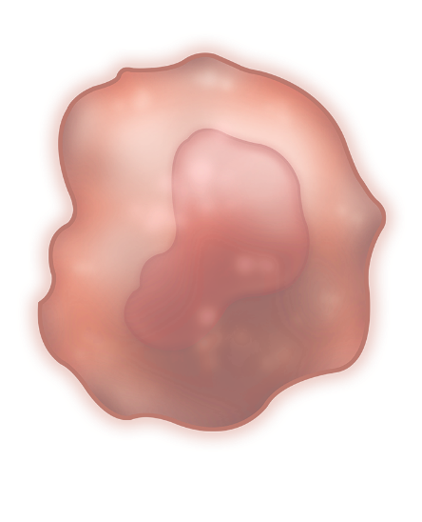


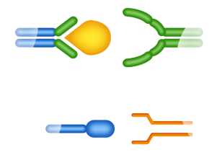

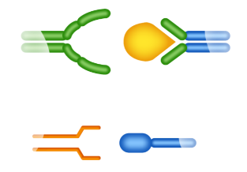
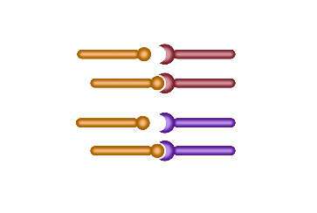

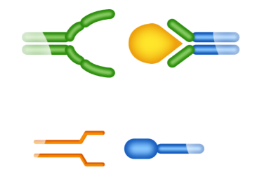

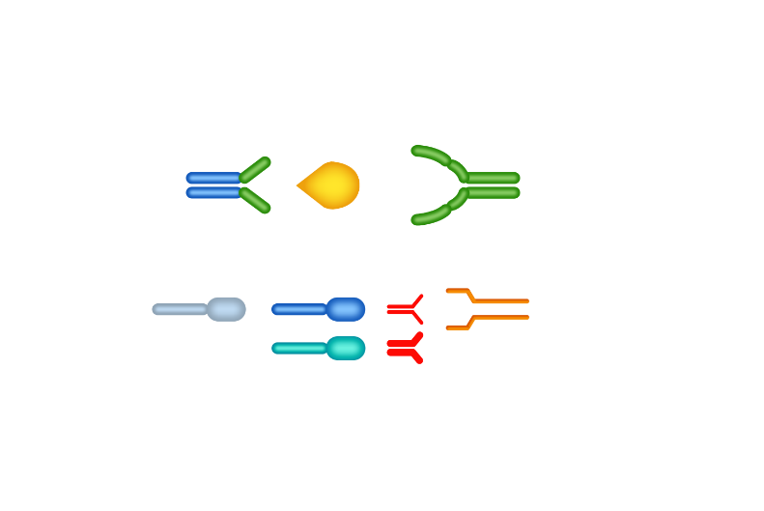
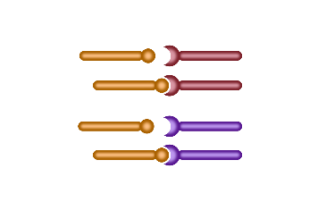
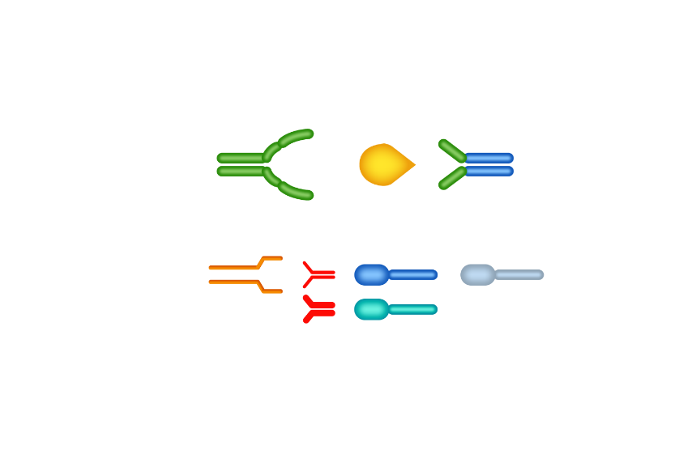

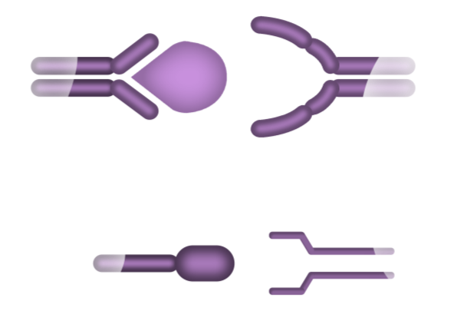

Immune Checkpoint Blockade: CTLA-4, PD-L1, PD-1
Immune-Related Adverse Events With Checkpoint Inhibitors
Dendritic cell
T cell
T cell
Tumor cell
MHC
TCR
+
TCR
MHC
+
+
+
+
+
B7
CD28
+
+
+
PD-1
PD-L1
B7
CTLA-4
-
-
-
-
-
-
anti–CTLA-4
anti–PD-L1/PD-1
-
-
-
PD-1
PD-L2
anti–PD-1
CTLA-4 blockade
PD-L1/PD-1 blockade
Adapted from Pardoll DM. Nat Rev Cancer. 2012;12:252-264 and Merelli B, et al. Critical Rev Oncol Hematol. 2014;89:140-165.

Slide 21
Spectrum of Immune-Related Toxicities
Immune-Related Adverse Events With Checkpoint Inhibitors
irAEs¹⁻⁴
Neurologic/
Ophthalmologic
Renal
Rheumatic
Gastro-
intestinal
Cutaneous
Pulmonary
Cardiac
Endocrine
Neuropathies
Demyelination
Uveitis
Guillain-Barré
Myasthenia
Nephritis
Inflammatory arthritis
Sicca syndrome
Polymyalgia rheumatica
Myositis
Vasculitis
Scleroderma
Colitis
Diarrhea
Hepatitis
Perforation
Pancreatitis
Rash
Pruritus
Dermatitis
Vitiligo
Psoriasis
Lichenoid eruption
Sarcoidosis
Sweet’s syndrome
Pneumonitis
Sarcoidosis
Myocarditis
Hypoadrenalism
Hypopituitarism
Hypo/hyper-thyroidism
Thyroiditis
Insulin-dependent diabetes
Hypophysitis
Not all toxicities are listed. 1. Abdel-Wahab N, et al. Add Exp Med Biol. 2017;995:155-174. 2. Calabrese LH, et al. Nat Rev Rheumatol. 2018;14:569-579. 3. Lemiale V, et al. Ann Intensive Care.2019;9:25. 4. Naidoo J, et al. Ann Oncol. 2015;26:2375-2391.

Slide 22
Frequencies of ICI - Induced irAEs
Immune-Related Adverse Events With Checkpoint Inhibitors
Distribution of Grade 1-2 irAEs¹
Distribution of Grade 3-5 irAEs¹
57
CTLA-4
15
18
CTLA-4
40
PD-1
PD-1
PD-L1
PD-L1
30
10
Patients (%)
Patients (%)
20
5
10
0
0
Skin
GI
Pulm
Endoc
Skin
GI
Pulm
Endoc
Skin
GI
Pulm
Endoc
Skin
GI
Pulm
Skin
GI
Pulm
Skin
GI
Pulm
Hepatic
Hepatic
Hepatic
Endoc
Endoc
Endoc
Arthralgia
Arthralgia
Arthralgia
Arthralgia
Hepatic
Arthralgia
Hepatic
Arthralgia
Hepatic
Neurol or ocul
Neurol or ocul
Neurol or ocul
Neurol or ocul
Neurol or ocul
Neurol or ocul
Distribution of Grade 1-2 and Grade 3-5 IRAEs for all tumor types in the main clinical trials with anti-CTLA4, anti-PD-1 or anti-PD-L1 antibodies as single therapies
1. Michot JM, et al. Eur J Cancer. 2016;54:139-148.

Slide 23
Incidence of ICI - Induced irAEs – PD-1/PD-L1 Antagonists
Immune-Related Adverse Events With Checkpoint Inhibitors
All-grade irAEs¹
Grade 3 or higher irAEs¹
AE | Incidence (95% CI) | Overall mean incidence of all-grade AEs (1.66%)
Endocrine dysfunction
Hypothyroidism | 6.07 (5.35-6.85)
Hyperthyroidism | 2.82 (2.40-3.29)
Hyperglycemia | 1.20 (0.91-1.55)
Thyroiditis | 0.75 (0.52-1.04)
Adrenal insufficiency | 0.69 (0.50-0.93)
Hypophysitis | 0.60 (0.42-0.82)
Type 1 diabetes | 0.43 (0.27-0.65)
Hypopituitarism | 0.26 (0.12-0.50)
Autoimmune thyroiditis | 0.20 (0.07-0.45)
Other disorder
Diarrhea | 9.47 (8.43-10.58)
AST increased | 3.39 (2.94-3.89)
Vitiligo | 3.26 (2.80-3.79)
ALT increased | 3.14 (2.71-3.62)
Pneumonitis | 2.79 (2.39-3.23)
Colitis | 1.24 (0.99-1.54)
Bilirubin increase | 1.05 (0.75-1.41)
Hepatitis | 0.85 (0.64-1.10)
Uveitis | 0.29 (0.15-0.51)
AE | Incidence (95% CI) | Overall mean incidence of grade 3 or higher AEs (0.11%)
Endocrine dysfunction
Hyperglycemia | 0.24 (0.13-0.38)
Adrenal insufficiency | 0.18 (0.10-0.30)
Type 1 diabetes | 0.18 (0.10-0.30)
Hypophysitis | 0.16 (0.09-0.27)
Hyperthyroidism | 0.08 (0.04-0.13)
Hypopituitarism | 0.07 (0.02-0.16)
Thyroiditis | 0.04 (0.01-0.10)
Hyperthyroidism | 0.04 (0.02-0.10)
Autoimmune thyroiditis | 0.02 (0.00-0.09)
Other disorder
AST increased | 0.75 (0.56-0.99)
ALT increased | 0.70 (0.52-0.93)
Pneumonitis | 0.67 (0.50-0.89)
Diarrhea | 0.59 (0.45-0.77)
Colitis | 0.47 (0.34-0.65)
Hepatitis | 0.43 (0.30-0.62)
Bilirubin increase | 0.15 (0.07-0.28)
Uveitis | 0.02 (0.00-0.07)
Vitiligo | 0.02 (0.00-0.06)
0
5
10
15
0
0,5
1
Incidence (95% CI)
Incidence (95% CI)
1. Wang Y, et al. JAMA Oncol. 2019. doi: 10.1001/jamaoncol.2019.0393. [Epub ahead of print].

Slide 24
Kinetics of ICI - Induced irAEs
Immune-Related Adverse Events With Checkpoint Inhibitors
irAEs with CPIs¹
Skin (n = 18)
5.6 (0.1–55.0)
19.4 (1.3–50.9)
Can occur months after treatment initiation, even after treatment discontinuation²
More defined time window for some AEs than others³
Onset generally earlier in patients who receive combination therapy⁴
Skin (n = 5)
Gastrointestinal (n = 46)
7.4 (1.0–48.9)
Gastrointestinal (n = 7)
26.3 (13.1–57.0)
Endocrine (n = 15)
12.1 (2.9–17.0)
Endocrine (n = 2)
28.6 (19.1–38.1)
Hepatic (n = 60)
7.4 (2.1–48.0)
Hepatic (n = 8)
14.1 (1.9–25.1)
Pulmonary (n = 3)
3.7 (3.7–9.4)
anti–PD-1 + anti–CTLA-4
Pulmonary (n = 1)
6.7 (6.7–6.7)
anti–PD-1
Renal (n = 6)
11.3 (3.3–23.7)
Renal (n = 1)
50.9 (5.09–50.9)
Weeks
0
10
20
30
40
50
60
1. Haanen JBAG, et al. Ann Oncol. 2017;28:iv119-iv142. 2. Michot JM, et al. Eur J Cancer. 2016;54:139-148. 3. Remon J, et al. J Thorac Dis. 2018;10:S1516-S1533 4: Naidoo J, et al. J Clin Oncol. 2017;35:709-717.

Slide 25
Kinetics of ICI - Induced irAEs
Immune-Related Adverse Events With Checkpoint Inhibitors
CTLA-4 Antagonists
PD-1/PD-L1 Antagonists
Toxicity grade
Toxicity grade
4
6
8
10
12
14
>30
4
6
8
10
12
14
>30
Duration of treatment (weeks)
Duration of treatment (weeks)
Colitis
Endocrinopathy
Nephritis
Liver toxicity
Skin, rash or pruritus
Pneumonitis
Martins et al. Nat Rev Clin Oncol 2019;16:563-580.

Slide 26
Clinical Course of Pneumonitis With Anti–PD-1/PD-L1 Therapy¹
Immune-Related Adverse Events With Checkpoint Inhibitors
915 patients received anti–PD-1 or anti–PD-L1 as monotherapy or in combination with
anti–CTLA-4¹
  01
  02
  03
  Overall incidence of pneumonitis was 5%, with a greater incidence in patients who received combination therapy than in those who received monotherapy (10% vs 3%; P < 0.001)
  Radiologic and pathologic features of pneumonitis were diverse
  100% of patients (5/5) who received an aTNF ± csDMARDs for worsening pneumonitis ultimately died
    Pneumonitis (1), infections associated with immunosuppression (3), progressive cancer (1)
1. Naidoo J, et al. J Clin Oncol. 2017;35:709-717.

Slide 27
Association Between irAEs and Outcomes
Immune-Related Adverse Events With Checkpoint Inhibitors
 | No. of studies |  | Pooled HR (95% CI) | Heterogeneity*
 |  |  |  | I² | p
IrAE type
Endocrine | 11 |  | 0.52 (0.44-0.62) | 0.0% | 0.872
 | 9 |  | 0.57 (0.48-0.68) | 0.0% | 0.788
Dermatological | 7 |  | 0.45 (0.35-0.59) | 26.3% | 0.228
 | 7 |  | 0.42 (0.34-0.53) | 18.5% | 0.278
Gastrointestinal | 5 |  | 0.68 (0.51-0.89) | 39.6% | 0.157
 | 4 |  | 0.79 (0.51-1.24) | 63.8% | 0.040
Pulmonary | 5 |  | 1.22 (0.59-2.52) | 70.0% | 0.010
 | 4 |  | 0.98 (0.57-1.69) | 58.3% | 0.066
Hepatobiliary | 3 |  | 0.98 (0.64-1.52) | 0.0% | 0.958
 | 3 |  | 0.94 (0.65-1.38) | 17.7% | 0.297
IrAE grade
Low grade (1-2) | 8 |  | 0.57 (0.43-0.75) | 32.7% | 0.167
 | 5 |  | 0.42 (0.31-0.57) | 30.2% | 0.220
Severe grade (≥3) | 4 |  | 0.99 (0.43-2.25) | 83.4% | <0.001
 | 4 |  | 0.80 (0.65-1.00) | 43.5% | 0.150
Overall | 26 |  | 0.54 (0.45-0.65) | 62.2% | <0.001
 | 22 |  | 0.52 (0.44-0.61) | 52.5% | 0.001
Meta-analysis of 30 studies (n=4971)
Patients who developed irAEs experienced both an OS benefit and a PFS benefit from ICI therapy compared to patients who did not develop irAEs. This was particularly evident in endocrine, dermatological, and low-grade irAEs.¹
        Another large meta-analyses has reported overall OS and PFS benefit in patients developing irAE while on ICI treatment.²
OS
PFS
Favours irAEs
Favours non-irAEs
Notes: *The χ² test and I² statistic were applied to estimate the between-study heterogeneity. Significant heterogeneity was indicated if p < 0.10 for the χ² test or I² > 50%
1. Zhou X, et al. BMC Med 2020:18(1). 2. Petrelli, F et al. J Immuno 2020;43(1):1-7

Slide 28
Association Between irAEs and Outcomes
Immune-Related Adverse Events With Checkpoint Inhibitors
Subgroup analyses for OS | No. of Studies |  | Pooled HR (95% CI) Random effect | I²
Patient Characteristics
Cancer type
NSCLC | 14 |  | 0.50 (0.39-0.63) | 62.6%
Melanoma | 7 |  | 0.58 (0.35-0.95) | 72.3%
Others | 5 |  | 0.63 (0.48-0.82) | 20.8%
Class of ICIs
Anti-PD-1 | 22 |  | 0.51 (0.42-0.62) | 56.1%
Anti-CTLA-4 | 3 |  | 0.89 (0.49-1.61) | 78.6%
Combination therapy
Yes | 4 |  | 0.62 (0.36-1.05) | 66.9%
No | 22 |  | 0.53 (0.43-0.65) | 62.8%
Meta-analysis of 30 studies (n=4971)
Notably, no significant OS benefit was seen in patients who developed irAEs in the Anti-CTLA-4 or Combination Therapy subgroups.
Favours irAEs
Favours non-irAEs
Notes: *The I² statistic was applied to estimate the between-study heterogeneity. Significant heterogeneity was indicated if I² > 50%
1. Zhou X, et al. BMC Med 2020:18(1).
Notes:
Subgroup analyses of the association between irAE development and OS

Slide 29
Association Between irAEs and Outcomes
Immune-Related Adverse Events With Checkpoint Inhibitors
Anti–PD-1 + anti–CTLA-4 in melanoma¹
Anti–PD-1 in melanoma²
OS: # of irAEs
(Log rank P = < 0.001)
100
1.0
90
83%
80
71%
0.8
70
73%
60
64%
0.6
Survival probability (%)
65%
Survival probability
50
54%
40
Median and 95% CI
0.4
# of irAEs
30
All Randomized anti–PD-1 + anti–CTLA-4
NR
0 (n = 56)
20
Discontinued due to AEs anti–PD-1 + anti–CTLA-4
NR
0.0
1-2 (n = 58)
10
All Randomized anti–CTLA-4
NR (11.9-NR)
3-4 (n = 20)
0
0.0
5-7 (n = 9)
0
3
6
9
12
15
18
21
24
27
30
0
25
50
75
100
125
150
175
200
225
Time (months)
OS (weeks)
1. Adapted from Hodi FS, et al. Lancet Oncol. 2016;17:1558-1568 and Hodi FS, et al. Poster. ASCO. 2016 (abstract 9518). 2. Freeman-Keller M, et al. Clin Cancer Res.
2016;22:886-894.

Slide 30
Association Between irAEs and Outcomes
Immune-Related Adverse Events With Checkpoint Inhibitors
Anti–PD-1/PD-L1 therapy in urothelial cancer (7 trials, n = 1747)¹
1.00
No irAEs
0.75
irAEs
Overall Survival (probability)
0.50
0.25
HR = 0.53 (95% CI, 0.43 to 0.66)
0
0
5
10
15
20
25
No. at risk (No. censored)
Time (months)
No irAEs | 1479 (0) | 814 (136) | 461 (287) | 111 (560) | 8 (653) | 1 (660)
irAEs | 268 (0) | 195 (24) | 139 (50) | 33 (139) | 3 (168) | 0 (171)
1. Maher VE, et al. J Clin Oncol. 2019. doi: 10.1200/JCO.19.00318. [Epub ahead of print].

Slide 31
Association Between irAEs and Outcomes
Immune-Related Adverse Events With Checkpoint Inhibitors
Anti-PD-(L)1 therapy in advanced NSCLC patients (N=267)¹
100
Median OS
No irAE: 12.5 mos
irAE: 28.2 mos
HR 0.38; 95% CI, 0.24-0.59; p < 0.001
Median PFS
No irAE:4.1 mos
irAE: 12.4 mos
HR 0.43; 95% CI, 0.28–0.64; p < 0.001
80
80
60
60
Overall Survival*, %
Progression-Free Survival, %
40
40
20
20
0
0
0
12
24
36
48
60
0
12
24
36
48
60
Time, months
Time, months
Notes: *Six and 12 months landmark analyses were also performed. No irAE vs irAEs: 12.9 months vs. 28.2 months (HR 0.39; 95% CI, 0.25–0.61; p < 0.001), and 19.6 months vs. not reached (HR 0.33; 95% CI, 0.17–0.64; p = 0.001).
1. Riudavets, M et al. Front Oncol. 2020;10:1677.

Slide 32
Association Between Use of Corticosteroids and Outcomes
Immune-Related Adverse Events With Checkpoint Inhibitors
Cellular effects of corticosteroids¹
Corticosteroids have wide-ranging anti-inflammatory and other effects
Inflammatory cells |  | Structural cells
CORTICOSTEROIDS
Eosinophil ↓ Numbers (apoptosis) |  |  | Epithelial cell ↓ Cytokines ↓ Mediators
T-lymphocyte ↓ Cytokines |  |  | Endothelial cell ↓ Leak
Mast cell ↓ Numbers |  |  | Airway smooth muscle ↑ β₂-receptors ↓ Cytokines
Macrophage ↓ Cytokines |  |  | Mucus gland ↓ Mucus secretion
Dendritic cell ↓ Dendritic cell
Studies have shown similar clinical outcomes in patients who require immunosuppression to treat irAEs and in those who do not require treatment^{2,3,4}
However, more recent studies have questioned this⁵⁻⁷
  It is likely that corticosteroids inhibit at least some elements of effective antitumor responses⁵
  The specific cellular and molecular immune mechanisms underlying toxicity are unlikely to precisely match those that cause tumor rejection e.g. IFN-𝛄 vs TNF-⍺⁸
Rheumatic irAEs often require high-dose corticosteroids and may require synthetic or biologic DMARD therapy^{9,10}
1. Barnes PJ. Pharmaceuticals. 2010;3:514-540. 2. Weber JS, et al. J Clin Oncol. 2017;35:785-792. 3. Horvat TZ, et al. J Clin Oncol. 2015;33:3193-3198. 4. Riudavets, M et al. Front Oncol. 2020;10:1677. 5. Faje AT, et al. Cancer. 2018;124:3706-3714. 6. Arbour KC, et al. J Clin Oncol. 2018;36:2872-2878. 7. Ricciuti B et al. J Clin Oncol. 2019. doi: 10.1200/JCO.19.00189. [Epub ahead of print] 8. Dougan M. Front Immunol. 2017;8:1547. 9. Calabrese LH, et al. Nat Rev Rheumatol. 2018;14:569-579. 10. Mitchell EL, et al. Eur J Cancer. 2018;105:88-102.

Slide 33
Association Between irAEs and Outcomes
Association Between irAEs and Outcomes
Immune-Related Adverse Events With Checkpoint Inhibitors
Retrospective review (N = 640)
Baseline steroid dose ≥10 mg prednisone equivalents (N = 90; 14%)
Indication for corticosteroid use
Dyspnea – 33%
Fatigue – 21%
CNS mets – 19%
Multivariate analysis (smoking history, PS, hx of CNS mets) - prednisone > or < 10 mg
PFS – 1.31 (95% CI 1.03 - 1.67)
OS – 1.66 (95% CI 1.28 – 2.16)
Dose-related effect observed
Response rates, progression-free survival (PFS), and overall survival (OS) of patients treated with programmed death-ligand 1 blockade on the basis of reported corticosteroid usage at Memorial Sloan Kettering Cancer Center (MSKCC) and Gustave Roussy Cancer Center (GRCC). Four hundred ﬁfty-one of 455 patients were evaluable for response in the MSKCC cohort and 185 of 185 patients were evaluable for response in the GRCC cohort. CR, complete response; POD, progression of disease; PR, partial response; SD, stable disease. Arbour et al. J Clin Oncol 2018;36:2872-2878.
Notes:
Note: Figures for ORR, PFS, and OS refer to MSKCC dataset. Figures from Gustave Roussy are similar but not shown here. Refer to the publication for more details (https://ascopubs.org/doi/pdf/10.1200/JCO.2018.79.0006)

Slide 34
Effect of Baseline Corticosteroid Use on Outcome with ICIs
Immune-Related Adverse Events With Checkpoint Inhibitors
PFS
OS
P < .001
P < .001
No. at risk:
No. at risk:
< 10 mg: | 402 | 50 | 13 | 5 | 3 | 2 | 0
≥ 10 mg: | 53 | 2 | 1 | 0 | 0 | 0 | 0
< 10 mg: | 402 | 180 | 67 | 28 | 13 | 2 | 2
≥ 10 mg: | 53 | 11 | 1 | 0 | 0 | 0 | 0
Prednisone < 10 mg (n = 402)
Prednisone ≥ 10 mg (n = 53)
Response rates, progression-free survival (PFS), and overall survival (OS) of patients treated with programmed death-ligand 1 blockade on the basis of reported corticosteroid usage at Memorial Sloan Kettering Cancer Center (MSKCC) and Gustave Roussy Cancer Center (GRCC). Four hundred ﬁfty-one of 455 patients were evaluable for response in the MSKCC cohort and 185 of 185 patients were evaluable for response in the GRCC cohort. CR, complete response; POD, progression of disease; PR, partial response; SD, stable disease. Arbour et al. J Clin Oncol 2018;36:2872-2878.
Notes:
Note: Figures for ORR, PFS, and OS refer to MSKCC dataset. Figures from Gustave Roussy are similar but not shown here. Refer to the publication for more details (https://ascopubs.org/doi/pdf/10.1200/JCO.2018.79.0006)

Slide 35
Effect of Baseline Corticosteroid Use on Outcome with ICIs
Immune-Related Adverse Events With Checkpoint Inhibitors
ORR
Retrospective review (N = 650)
P =.01
Baseline steroid dose ≥10 mg prednisone equivalents
Malignancy-related steroid use (10.2%, N = 66)
CNS mets – 57.6%
Cancer related dyspnea – 18.2%
Pain from bone mets – 16.7%
Anorexia – 7.6%
Malignancy unrelated steroid use (4.2%, N = 27)
Pneumonitis from prior chemo/CRT – 25.9%
COPD – 22.2%
Autoimmune disease – 18.5%
Iodinated contrast prophylaxis – 14.8%
No difference in outcomes when isolating pts on corticosteroids for cancer unrelated indications
Outcomes to immunotherapy in the group of patients treated with ≥10 mg of prednisone for cancer-related palliative indications or cancer-unrelated indications compared with the group of patients receiving less than 10 mg of prednisone according to overall response rate, progression-free survival (PFS), and overall survival (OS). HR, hazard ratio; NR, not reached. Ricciuti et al. J Clin Oncol 2019;37:2872-2878.

Slide 36
Effect of Baseline Corticosteroid Use on Outcome with ICIs
Immune-Related Adverse Events With Checkpoint Inhibitors
PFS
OS
No. of events | Median (months, 95% CI)
462/557 | 3.4 (2.7 to 3.9) Relative to 0 to < 10 mg group
60/66 | 1.4 (1.2 to 2.1) HR, 1.87; 95% CI, 1.43 to 2.45; P < .001
21/27 | 4.6 (2.8 to 15.3) HR, 0.77; 95% CI, 0.50 to 1.19; P = .24
No. of events | Median (months, 95% CI)
362/557 | 11.2 (9.9 to 12.9) Relative to 0 to < 10 mg group
52/66 | 2.2 (1.5 to 5.9) HR, 2.38; 95% CI, 1.78 to 3.19; P = .001
19/27 | 10.7 (6.9 to NR) HR, 0.93; 95% CI, 0.59 to 1.48; P = .77
No. at risk:
No. at risk:
Prednisone 0 to < 10 mg | 557 | 91 | 35 | 10 | 4 | 0
Prednisone ≥ 10 mg (cancer-related) | 66 | 6 | 1 | 0 | 0 | 0
Prednisone ≥ 10 mg (cancer-unrelated) | 27 | 8 | 2 | 0 | 0 | 0
Prednisone 0 to < 10 mg | 557 | 213 | 75 | 17 | 7 | 1 | 0
Prednisone ≥ 10 mg (cancer-related) | 66 | 8 | 3 | 1 | 0 | 0 | 0
Prednisone ≥ 10 mg (cancer-unrelated) | 27 | 11 | 4 | 2 | 0 | 0 | 0
Prednisone 0 to < 10 mg
Prednisone ≥ 10 mg (cancer-related)
Prednisone ≥ 10 mg (cancer-unrelated)
Outcomes to immunotherapy in the group of patients treated with ≥ 10 mg of prednisone for cancer-related palliative indications or cancer-unrelated indications compared with the group of patients receiving less than 10 mg of prednisone according to overall response rate, progression-free survival (PFS), and overall survival (OS). HR, hazard ratio; NR, not reached. Ricciuti et al. J Clin Oncol 2019;37:2872-2878.

Slide 37
Association Between Use of Corticosteroids and Outcomes
Immune-Related Adverse Events With Checkpoint Inhibitors
Anti–PD-1/PD-L1 therapy in urothelial cancer
(7 trials, n =1747)¹
Responding patients were observed to have a similar duration of response, regardless of corticosteroid use
No systemic corticosteroids
Systemic corticosteroids
HR = 1.09 (95% CI, 0.70 to 1.69)
No. at risk (No. censored)
No systemic corticosteroids | 267 (0) | 232 (23) | 160 (64) | 72 (121) | 20 (146) | 4 (158) | 1 (160)
Systemic corticosteroids | 84 (0) | 76 (3) | 55 (13) | 28 (33) | 8 (46) | 1 (53) | 0 (53)
1. Maher VE, et al. J Clin Oncol. 2019. doi: 10.1200/JCO.19.00318. [Epub ahead of print].

Slide 38
Association Between Use of Corticosteroids and Outcomes
Immune-Related Adverse Events With Checkpoint Inhibitors
Retrospective review of 267 patients with advanced NSCLC treated with anti-PD-(L)1
100
no corticosteroids or <10mg prednisone equivalent/day
≥10mg prednisone equivalent for management of irAEs
80
≥10mg prednisone equivalent for management
of cancer-related symptoms
n=146 (54.7%) received corticosteroids during anti-PD-(L)1 therapy
n=134 (91.8%) required ≥10 mg of prednisone equivalent per day
59 patients (44%) for the treatment of irAEs
75 patients (56%) for the management of cancer-related symptoms
60
Overall Survival, %
40
20
0
0
12
24
36
48
60
Time, months
                No difference in OS was seen in patients receiving no corticosteroids or <10 mg prednisone equivalent daily VS ≥10 mg for the management of irAEs, p = 0.314
                Patients receiving ≥10 mg for the management of cancer-related symptoms had a shorter OS than the rest of the study population*, p = 0.001
Notes: * Includes patients who did not receive corticosteroids or <10 mg prednisone equivalent daily and those who received them for the management of irAEs
1. Riudavets, M et al. Front Oncol. 2020;10:1677.

Slide 39
Treatment Considerations
Immune-Related Adverse Events With Checkpoint Inhibitors
Interprofessional collaboration regarding intensity and duration of concomitant therapies and compatibility with continued CPI therapy¹
Restarting CPIs after an irAE
Depends on severity of irAE and patient’s tumor response status²
Retrospective studies have shown that irAEs associated with one class of agent (eg, anti−CTLA-4) may not recur with subsequent treatment (eg, anti−PD-1)³
1. Naidoo J, et al. J Natl Compr Canc Netw. 2019;17:712-720 2. Brahmer JR, et al. J Clin Oncol. 2018;36:1714-1768. 3. Menzies AM, et al. Ann Oncol. 2017;28:368-376.

Slide 40
Personalized Treatment of irAEs¹
Immune-Related Adverse Events With Checkpoint Inhibitors
Affected organ(s) biopsy available?
Yes
No
Immune-type predominant infiltrate
Anti–Il-6, anti-TNFα or anti–Il-1
Lymphocytic
Monocytic, neutrophilic and/or granulomatous features
Response to therapy?
T-cell prominent
Mixed pattern with B cell/plasma cells
No
Yes
Anti–Il-6
AntiCD20 or anti-BAFF
Anti-TNFα
Response to therapy?
No
Second course (after 2 weeks)
Steroid tapering
Yes
Response to therapy?
Yes
No
Switch therapy
Steroid tapering
First-line treatment
Anti–Il-6, anti–Il-1, anti–Il-12 and anti–Il-23,
anti–Il-17 or anti-TNFα
Yes
Response to therapy?
No
Second-line treatment
Anti-integrin α4, Janus kinase inhibitor or non-selective immunosuppression
Yes
Response to therapy?
No
Third-line treatment
Alkylating agent, plasmapheresis
1. Adapted from Martins F, et al. Lancet Oncol. 2019;20:e54-64.

Slide 41
Comparison of Consensus Guidelines
Immune-Related Adverse Events With Checkpoint Inhibitors
 | ASCO¹ | NCCN² | ESMO³ | SITC⁴
Year Published | 2021 | 2021 (v4.2021) | 2017 | 2021
Goal/Objectives | Increase awareness, outline strategies, offer guidance on management of irAEs in CPI-treated patients | Provide guidance on the management of irAEs resulting from cancer immunotherapy | None explicitly provided | Provides guidance on management of irAEs to improve patient outcomes during and following treatment with ICIs
Methods | Interdisciplinary panel Guidelines developed per systematic literature review (2017-2021) and informal consensus process | Interdisciplinary panel, including NCCN/ASCO members Consensus recommendations literature and/or expert opinion based | Per ESMO SOP Recommendations provided with grades and LoE, literature selected by expert authors | Interdisciplinary panel Consensus recommendations per literature and/or accumulated clinical experience
Unique Content Highlights | Immunotherapy wallet card Sections on patient communication, on-going studies, and a detailed table on prevention and management of AEs d/t steroid use | Sections on principles of immunosuppression, patient education, immunotherapy rechallenge, and routine monitoring | Succinct summary of irAE recommendations, separate patient guide | Guidance on pre-treatment considerations and when to refer
1. Schneider BJ, et al. J Clin Oncol. 2021; JCO2101440. 2. Referenced with permission from the NCCN Clinical Practice Guidelines in Oncology (NCCN Guidelines®) for Management of Immunotherapy-Related Toxicities V.4.2021. © National Comprehensive Cancer Network, Inc. 2021. All rights reserved. Accessed [Nov 2, 2021]. To view the most recent and complete version of the guideline, go online to NCCN.org. NCCN makes no warranties of any kind whatsoever regarding their content, use or application and disclaims any responsibility for their application or use in any way. 3. Haanen JBAG, et al. Ann Oncol. 2017;28:v119-iv142. 4. Brahmer J, et al. J Immunother. 2021;9:e002435.

Slide 42
Comparison of Consensus Guidelines (cont.)
Immune-Related Adverse Events With Checkpoint Inhibitors
There is overlap between the guidelines on management of specific AEs
ASCO¹ and SITC² guidelines also provide general guidance
Grade | ASCO¹ | SITC²
Grade 1 | Continued CPI with close monitoring | Continue immunotherapy and monitor for worsening symptoms
Grade 2 | Suspend CPI Consider resuming once ≤ G1 Corticosteroids may be administered | Withold CPI Corticosteroids may be administered Continue CPI once signs and symptoms have resolved or are controlled with ≤10 mg of prednisone (or equivalent) per day
Grade 3 | Suspend CPI Initiate high-dose corticosteroids; taper over at least 4 to 6 weeks Some refractory cases may require infliximab or other immunosuppressive therapy | No general recommendation
Grade 4 | Permanent discontinuation recommended | No general recommendation
1. . Schneider BJ, et al. J Clin Oncol. 2021; JCO2101440. 2. Brahmer J, et al. J Immunother. 2021;9:e002435

Slide 43
Treatment of Patients With Pre-Existing Rheumatic Diseases
Immune-Related Adverse Events With Checkpoint Inhibitors
Patients with pre-existing rheumatic diseases were not included in clinical trials of CPIs
Patients with rheumatic disease should be considered for preemptive referral to a rheumatologist prior to immunotherapy and early referral in the event of rheumatic irAEs⁵
Up to 44% of patients with immune-mediated inflammatory diseases treated with CPIs will experience disease flares¹⁻⁴
Rheumatic irAEs often require high-dose corticosteroids and may require synthetic or biologic DMARD therapy⁵⁻⁶
  Risks and benefits of prolonged DMARD therapy (conventional and biologic)
27% to 29% may develop de novo irAEs after receiving CPIs¹⁻³
  Small prospective study showed patients with pre-existing autoimmunity were more likely to have earlier onset of irAEs than those without pre-existing autoimmunity⁴
1. Johnson DB, et al. JAMA Oncol. 2016;2:234-240. 2. Johnson DB, et al. Cancer. 2017;123:1904-1911. 3. Menzies AM, et al. Ann Oncol. 2017;28:368-376. 4. Danlos FX, et al. Eur J Cancer. 2018;91:21–29. 5. Calabrese LH, et al. Nat Rev Rheumatol. 2018;14:569-579. 6. Mitchell EL, et al. Eur J Cancer. 2018;105:88-102 6.

Slide 44
CPI Treatment in Patients With HIV
Immune-Related Adverse Events With Checkpoint Inhibitors
Of 70 patients with HIV who received CPIs identified in case reports¹:
  CPI therapy was generally well tolerated, with 6 patients (9%) experiencing grade 3 or higher irAEs
  Of the 28 patients with undetectable HIV load, HIV remained suppressed in 26 (93%)
  Of the 25 patients with paired pretreatment and posttreatment CD4-cell counts, 14 (56%) had an increase in CD-4 count and 11 (44%) had a decrease; mean (SD) change, 12.3 (28.5)/μL (range, −290 to 296/μL)
  ORRs were 30% for NSCLC, 27% for melanoma and 63% for Kaposi sarcoma
  Phase I and II clinical trials examining the use of CPIs in patients with HIV infection are ongoing
1. Cook MR and Kim C. JAMA Oncol. 2019. doi: 10.1001/jamaoncol.2018.6737 [Epub ahead of print].

Slide 45
Summary
Immune-Related Adverse Events With Checkpoint Inhibitors
Detailed consensus guidelines have been developed for the diagnosis and management of irAEs¹⁰⁻¹³; algorithms for personalized treatment of refractory irAEs have also been published¹⁴
Anti–PD-1 and anti–PD-L1 therapies may be associated with different incidences of AEs¹
For patients with pre-existing rheumatic disease, pre-emptive referral to a rheumatologist prior to immunotherapy and early referral in the event of rheumatic irAEs should be considered¹⁵
The relationship between development of irAEs and treatment outcome is evolving²⁻⁷
Corticosteroids do not seem to impair outcomes when used to treat irAEs⁷⁻⁹
CPIs are generally well tolerated in patients with HIV, and Phase I and II clinical studies of patients with HIV treated with CPIs are ongoing¹⁶
1. Wang Y, et al. JAMA Oncol. 2019. doi: 10.1001/jamaoncol.2019.0393. [Epub ahead of print]. 2. Hodi FS, et al. Poster. ASCO. 2016 (abstract 9518). 3. Freeman-Keller M, et al. Clin Cancer Res. 2016;22:886-894. 4. Maher VE, et al. J Clin Oncol. 2019. doi: 10.1200/JCO.19.00318. [Epub ahead of print]. 5. Zhou X, et al. BMC Med 2020:18(1). 6. Petrelli, F et al. J Immuno 2020;43(1):1-7. 7. Riudavets, M et al. Front Oncol. 2020;10:1677. 8. Weber JS, et al. J Clin Oncol. 2017;35:785-792. 9. Horvat TZ, et al. J Clin Oncol. 2015;33:3193-3198 10. Schneider BJ, et al. J Clin Oncol. 2021; JCO2101440 11. NCCN Clinical Practice Guidelines in Oncology (NCCN Guidelines®); NCCN.org. 12. Haanen JBAG, et al. Ann Oncol. 2017;28:v119-iv142. 13. Puzanov I, et al. J Immunother. 2021;9:e002435. 14. Martins F, et al. Lancet Oncol. 2019;20:e54-64. 15. Calabrese LH, et al. Nat Rev Rheumatol. 2018;14:569-579. 16. Cook MR and Kim C. JAMA Oncol. 2019. doi: 10.1001/jamaoncol.2018.6737 [Epub ahead of print].

