Slide 1


Value Based Oncology and Policy
FLASCO Fellows and Residents Oncology Conference
Michael Diaz
Stephen Grubbs
Ted Okon
March 19, 2022

Slide 2
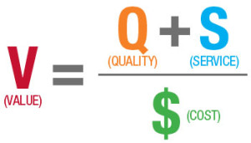
Health Care Payment Definitions
Health Care Value
Fee For Service
  Reimbursement based on what and how many services are provided
Value Based Care
  Reimbursement is contingent upon the quality of the care provided and it comes tethered to patient outcomes and resource utilization
Alternative Payment Model (APM)
  Payment approach that gives added incentive payments to provide high quality and cost-efficient care (value)

Slide 3
Value Based Care Relationship
Alternative Payment Model
Care Delivery System
Notes:
Must have both payment model and care delivery model
What is the problem you are trying to address? The OMH is the care delivery system/practice transformation tool to support practices in oncology payment reform

Slide 4
A Framework for Alternative Payment Models
A
Foundation Payments
for Infrastructure
& Operations
B
Pay for Reporting
C
Pay for Performance
A
APMs with
Shared Savings
B
APMs with Shared Savings & Downside Risk
A
Condition-Specific
Population-Based Payment
B
Comprehensive
Population-Based Payment
C
Integrated Finance &
Delivery System
Health Care Payment Learning & Action Network. Alternative Payment Model Framework White Paper Refreshed. 2017.

Slide 5
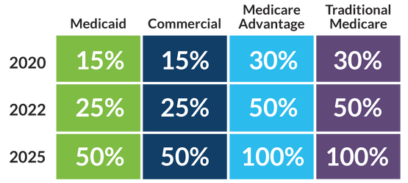
A Journey Towards Alternative Payment Models
Targets
Adoption of two-sided risk alternative payment models, with the percentage of payments in such models meeting or exceeding the following percentages:
2020 Actuals
Medicaid: 14.5%
Commercial: 10.8%
Medicare Advantage: 29.3%
Traditional Medicare: 24.2%
Health Care Payment Learning & Action Network. HCPLAN Overview. 2019.
Notes:
Commercial is currently at 10.6%, Medicare Advantage at 24.3%, Traditional at 18.2%, Medicaid at 8.3%

Slide 6
Oncology Care Model
Centers for Medicare & Medicaid Innovation (CMMI)
Started July 1, 2016
Ends June 30, 2022
126 practices (197 originally)
5 payers (19 originally)
MEOS: $160 per patient, per month
One- and Two-Sided Risk
Performance Methodology
  Total cost-of-care vs. predicted amount
  Shared savings / risk, adjusted by quality
Management
of Appropriate Payment Structure
Comprehensive Coordinated Cancer Care
Patient Centered Care
Strategic use
of Revenue
Continuous Improvement Driven by Data

Slide 7
Discussion

