Slide 1
Case presentation
Beatrice Alvarado Roberts, MD
University of Florida
FLASCO Spring Session
April 17, 2021

Slide 2
Case presentation
64-year-old African American female had an abnormal screening mammogram in 09/2019:
  Multilobulated, spiculated mass involving the upper outer aspect of the left breast measuring 4.6 x 2.5 x 3 cm
  Nodular well-defined density seen in close proximity (likely a large pathological axillary lymph node)
  Ultrasound of the breast was recommended and ordered
    ”Unable to leave message for patient, mailbox full”
She noticed left breast mass and went to PCP early March 2020 → advised to go to ER for expedited work up

Slide 3
Case presentation
Left breast mass and LN biopsy March 4, 2020:
  Invasive ductal carcinoma, grade 3, ER+, PR+, HER2 negative
  Lymph node positive with metastatic carcinoma
  Repeat mammogram: 5.6 x 4.2 cm mass
  cT3N1
Referred to medical oncologist one week later for further evaluation

Slide 4
Initial Visit to Medical Oncology
March 12, 2020
Patient states she was unaware or never informed of abnormal screening mammogram in September 2019
PMH:
  5 CVA’s since 2016
  1 myocardial infarction
  Insulin-dependent diabetes mellitus
  January: admission for glucose “700’s”
  Pacemaker for “heart beat below 20’s”
  Psychiatric: Bipolar, OCD, PTSD
PSH:
  Hysterectomy
  Pacemaker placement

Slide 5
Initial Visit to Medical Oncology
Family history:
  Breast cancer: Maternal grandmother (age unknown)
  Breast cancer: Mother (age 70)
  Lung cancer: Mother (age 83)
  Lung cancer: Father (age unknown)
Social history:
  Lived in California until 2016 when she visited her daughter, son-in-law and grandchildren in Florida → suffered first CVA in 2016
  Subsequently stayed in Florida living with son-in-law’s parents
  On Disability since 2000 for complex psychiatric issues
  Under psychiatrist’s care for complex diagnoses: adherent to her medications
  Unaccompanied, used public transport to attend appointment

Slide 6
Initial Visit to Medical Oncology
More social history:
  Now lives in a rented room on SSI: ~$750/month
  Food stamps
  Current every day smoker: ¼ per day for 40 years (10 pack years)
  Occasional EtOH use
  Polysubstance abuse, sexual abuse, incarcerations: “all in the past”
  Actively involved in a Christian church

Slide 7
Initial Visit to Medical Oncology
Left breast exam: Mass 10 cm greatest diameter, no skin changes, hard, enlarged axillary lymph node, no lymphedema. Left chest pacemaker.
Other pertinent exam findings: BMI 30, ECOG 1
Labs: unremarkable
CT head with IV contrast: no brain metastasis
Recommendations:
  PET/CT ASAP to rule out distant metastatic disease
  Genetic consultation due to family history of breast cancer (negative)
  Breast surgeon: breast conservation vs mastectomy, LN dissection discussed

Slide 8
Follow-up
Multiple attempts were made to try and reach patient for follow up: “mailbox full”
  Audio visit offered and scheduled for April 23rd (5 weeks from initial visit)
    Patient cancelled
  “Stopped responding to phone/email”
  13 phone calls, 4 letters, certified letter in the mail
  Not active on “MyChart”
  Emergency contact listed: “friend”
    No family listed

Slide 9
Follow-up
She presented for first follow-up appointment September 24, 2020 (six months later) after receiving a certified letter in the mail from breast oncology clinic
  Unaccompanied
  Did not receive care in the interim
  Elected prayer, lime directly applied to breast tumor and orally ingested aloe vera as home remedies
  Feels well. “No change” to breast mass.
  “I do not want to be cut”
  “Holy spirit” is telling her to listen to the treatment recommended for her
PET CT ordered and scheduled while patient was in clinic
Neoadjuvant chemotherapy (AC-T), surgery (likely mastectomy/ALND), radiation (PMRT) and adjuvant endocrine treatment were discussed

Slide 10
Follow-up
She became agreeable to surgery after explaining that it was required for cure if distant disease ruled out
Repeat PET CT:
  Left breast mass appears slightly larger in size, no distant metastasis
Treatment:
  Neoadjuvant ddAC-T

Slide 11
Treatment Course
Neoadjuvant weekly Paclitaxel started October 19, 2020
Completed 10/12 cycles of weekly Paclitaxel: December 28, 2020
  Stopped early due to neuropathy and skin toxicity
Gap between Paclitaxel and AC due to prior authorization issue
  Patient changed insurance and PCP’s at start of the year
  Also changed phone numbers → delay in communication
  Emergency contact called
ddAC scheduled for February 22, 2021
  Rescheduled for February 25th due to medical transport scheduling: C1D1 ddAC started!
  Did not have premedication (dexamethasone, olanzapine, aprepitant) available despite reminder phone call the day before and written instructions
    Clinic staff assisted in obtaining medication same day

Slide 12
In Summary
We have a complex patient with multiple comorbidities and stage III left breast invasive ductal carcinoma grade III, ER+PR+, HER2 -, gBRCA- with various health disparities that impacted her care and caused a delay in treatment (on more than one occasion)

Slide 13
What Kind of Disparities Impacted Her Cancer Care?
Racial
DELAY IN CARE
Socioeconomic
African American female
Mental Health
Low income
Transportation issues
Food stamps
Unstable housing
Lack of social support
Communication barriers
Distrust
Bipolar disorder
OCD
PTSD
History of sexual abuse, polysubstance abuse
Holistic medicine
Spiritual views

Slide 14
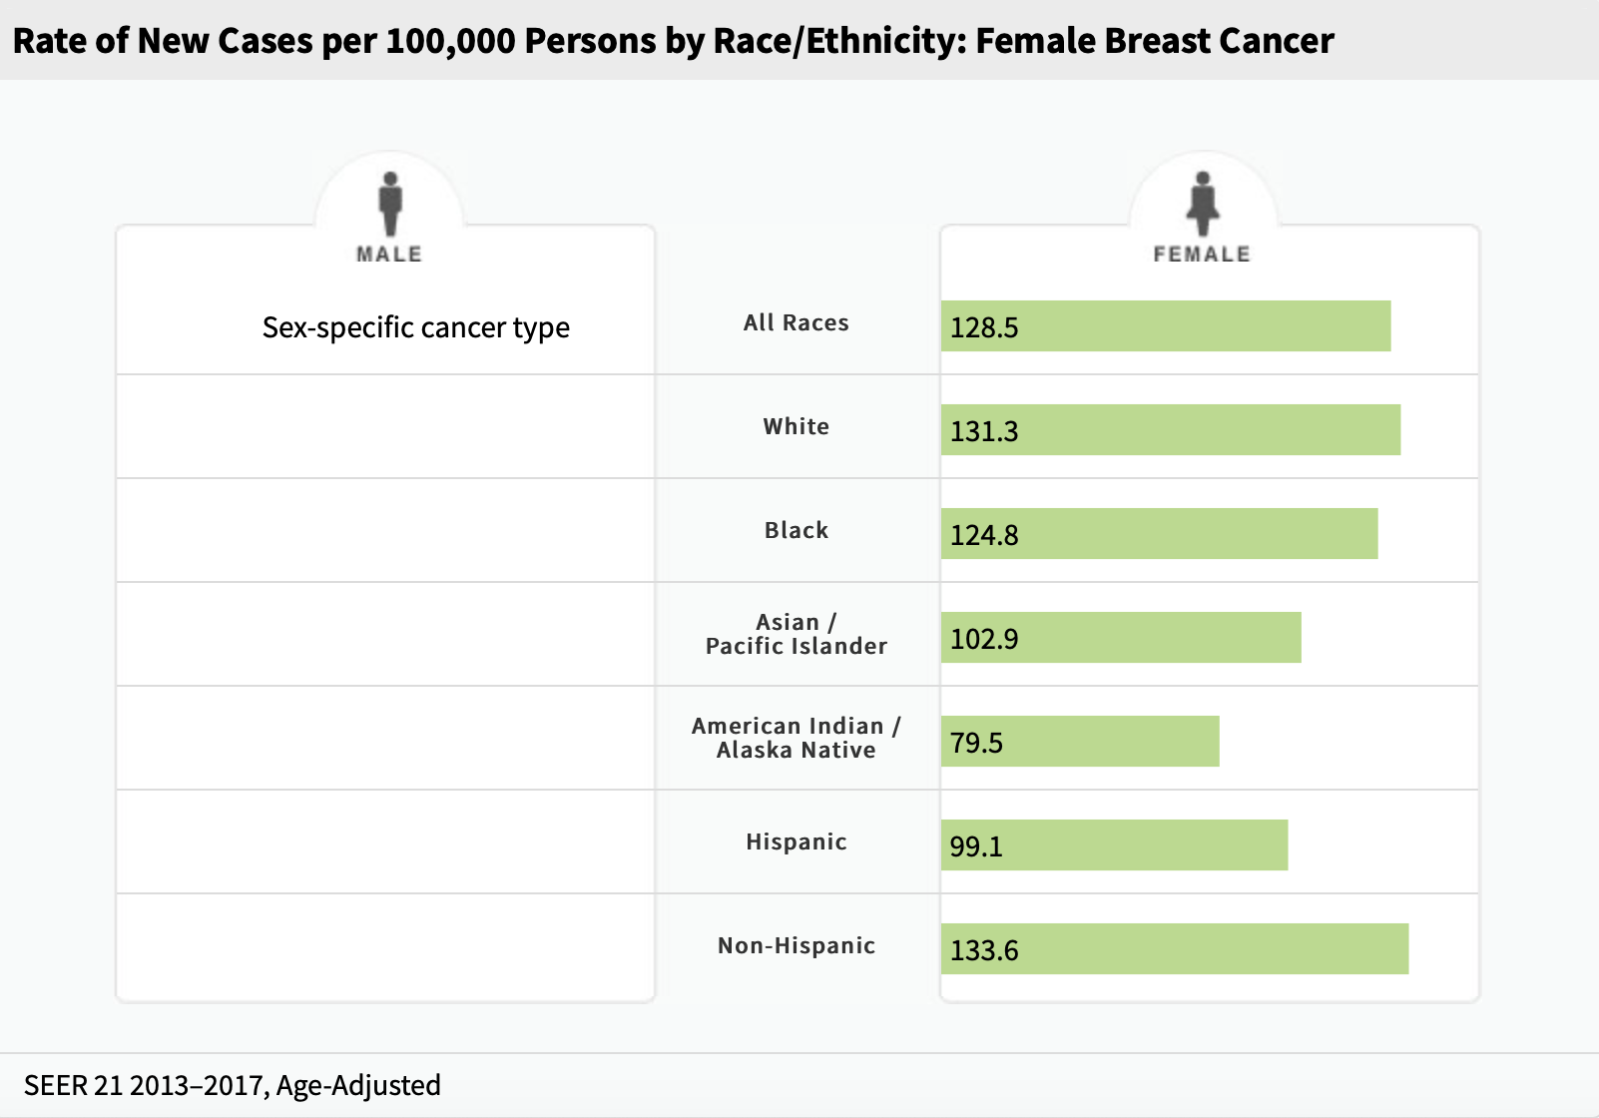
Racial Variations in Breast Cancer Incidence
https://seer.cancer.gov/statfacts/html/breast.html

Slide 15
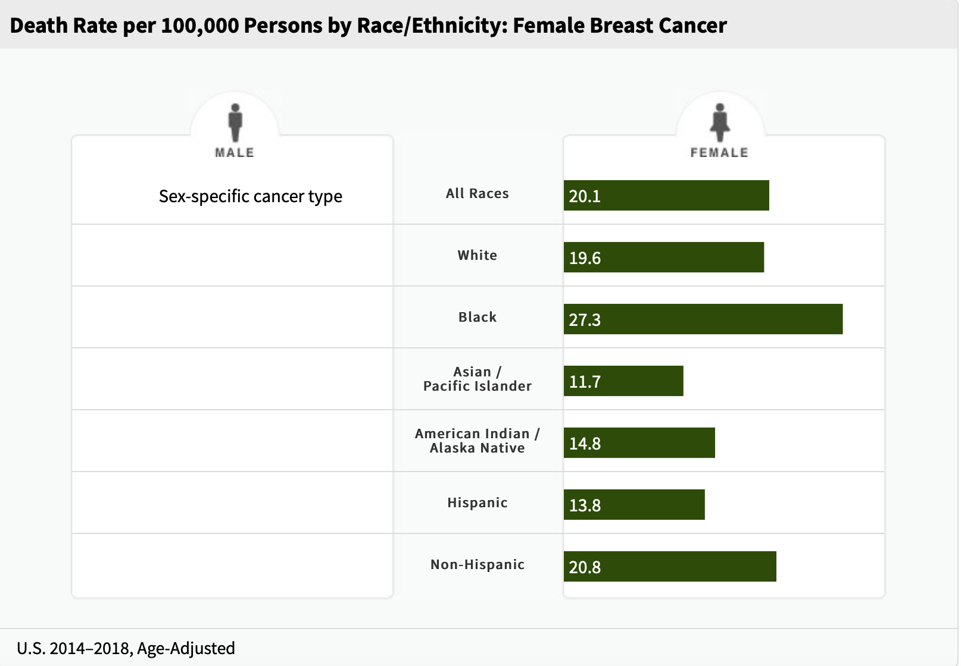
Racial Variations in Breast Cancer Mortality
https://seer.cancer.gov/statfacts/html/breast.html

Slide 16
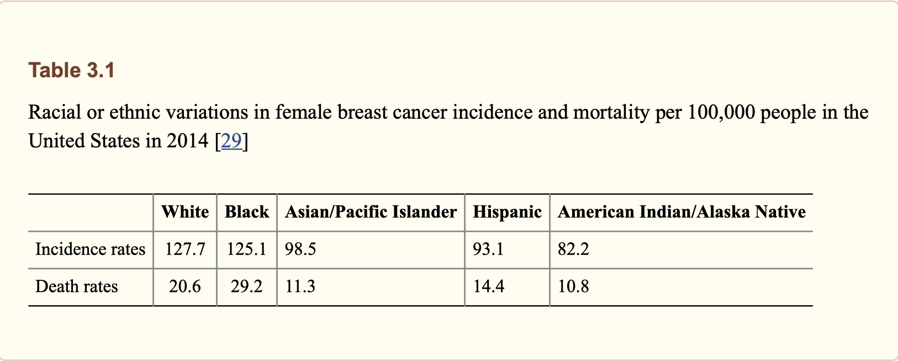
Racial Variations in Breast Cancer Mortality
Conclusion: black women are 42% more likely to die from breast cancer compared to white women
Yedjou et al. Adv Exp Med Biol. 2019 ; 1152: 31–49

Slide 17
Discussion
Blasé N. Polite, MD, MPP, FASCO
Kathy Fu, MD
Beatrice Alvarado Roberts, MD
Julie Gralow, MD

